Slide 1

Outland Adventures
Breanna Gorham
Natasha Foreman
Garrett Rhodes
Luis Crus

Slide 2
Case Study Summary
Outland Adventures was founded by Blythe Timmerson and Jim Ford, two passionate outdoor enthusiasts who initially launched the business as a part-time venture. Their vision was to create guided hiking and camping trips for others who shared their love for remote adventures. As the demand for their services grew, they decided to commit fully to the business and left their previous jobs to focus on Outland Adventures full-time. To support the expansion, they brought on additional team members: John “Mac” MacNell and D.B. “Duke” Marland were hired as guides to plan and organize trips, including researching airfare, visa requirements, and necessary vaccinations. Anita Gallegos was brought in to manage marketing efforts, while Dimitrios Stravopolous was responsible for ordering supplies and maintaining the equipment inventory. Most recently, Mei Wong joined the team to develop an e-commerce website allowing customers to access trip information, view schedules, and purchase or rent camping gear. As operations continued to grow, Blythe and Jim began considering ways to optimize the business. They wanted to assess whether customers were purchasing enough equipment to justify ongoing sales, whether any regions were experiencing a decline in bookings, and if any inventory had aged beyond five years and needed to be replaced.

Slide 3
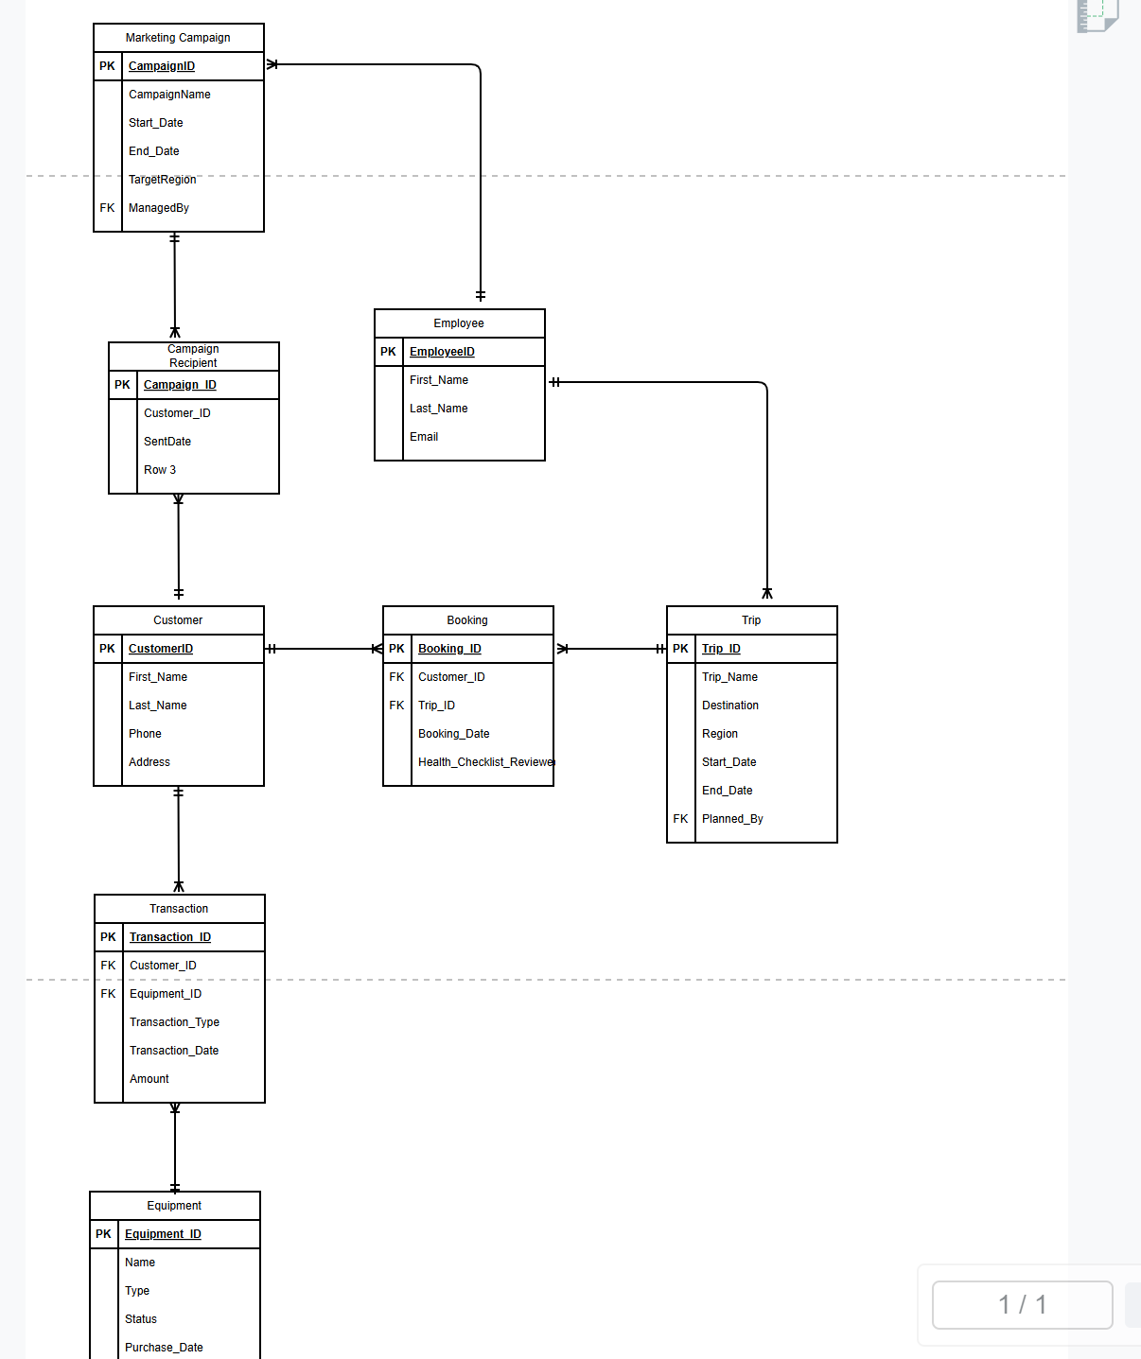
ERD

Slide 4
Reports and Their Purpose
* Equipment Purchase Summary * Booking Trends by Region and Year * Inventory Older Than 5 Years

Slide 5
Equipment Sales Summary
This report summarizes customer purchases of equipment, showing how many unique customers bought each item, the total number of purchases, and the revenue generated. It helps determine if enough customers are buying equipment to sustain equipment sales at Outland Adventures. Currently, no purchase transactions have been recorded, indicating low or no equipment sales to date.

Slide 6
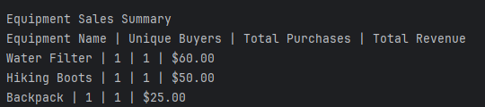
Equipment Sales Report

Slide 7
Booking Trends by Region and Year
This report shows the total number of trip bookings segmented by region and year. It highlights booking patterns over time across the three main, Africa, Asia, and Europe. This insight helps identify if any region is experiencing a downward trend in bookings.

Slide 8
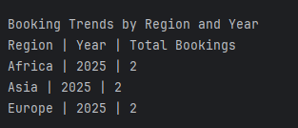
Booking Trends by Region and Year Report

Slide 9
Inventory Older Than 5 Years
This report lists all equipment items that were purchased over five years ago. Monitoring the age of inventory is crucial for Outland Adventures to assess if anything needs replacement due to wear or tear, ensuring safety and quality standards for customers.

Slide 10
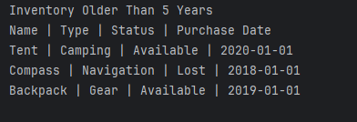
Inventory Older Than 5 Years

Slide 11
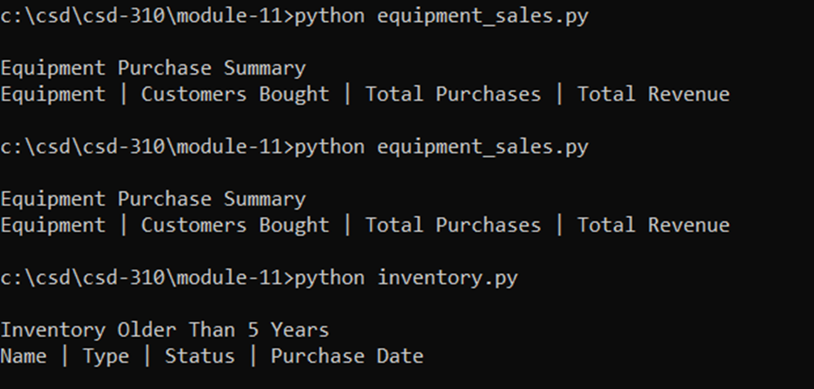

Slide 12
Assumptions
All equipment purchase dates are accurately recorded and stored in the database.
Bookings are linked to regional identifiers within the Trip table
The database contains no historical equipment sales to date, explaining the lack of data in that report.
We assume one piece of equipment per sale transaction for simplicity, but this can be expanded later.

